Slide 1
Politechnika Gdańska
RESEARCH PROJECT
(GARBAGE COLLECTOR ROBOT)

Slide 2
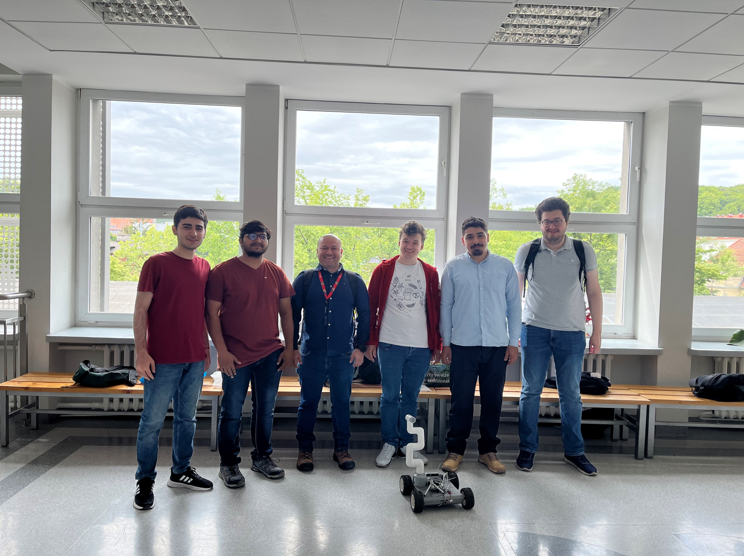
OUR TEAM’s MEMBERS
Andrii Melnyk - s196900
Ahmad Shehada - s197063
Murad Abdullayev - s196353
Johan Carcamo - s196763
Arda Candas - s196696
Nirav Vaghasiya – s196738

Slide 3
MAIN TARGET OF PROJECT
Create prototypes of robot which able to move inside university campus, detect and classify garbage. Pick up garbage put it into container and transport to collecting station. Process of robot movement, navigation and garbage collection should be fully automated.

Slide 4
ABOUT THE PLATFORM
MOBOT – EXPLORER –A1. The mobile platform for further expansion is based on a solid construction made of steel sheet and equipped with four DC motors with a planetary gearbox from a reputable manufacturer and tires adapted to move in difficult terrain. Mobot-Explorer-A1 is equipped with a control system based on the ATmega128 microcontroller and integrated mulching of the gel batteries (included). The applied system enables autonomous work of the robot after addition of appropriate sensors.ifficult terrain.

Slide 5
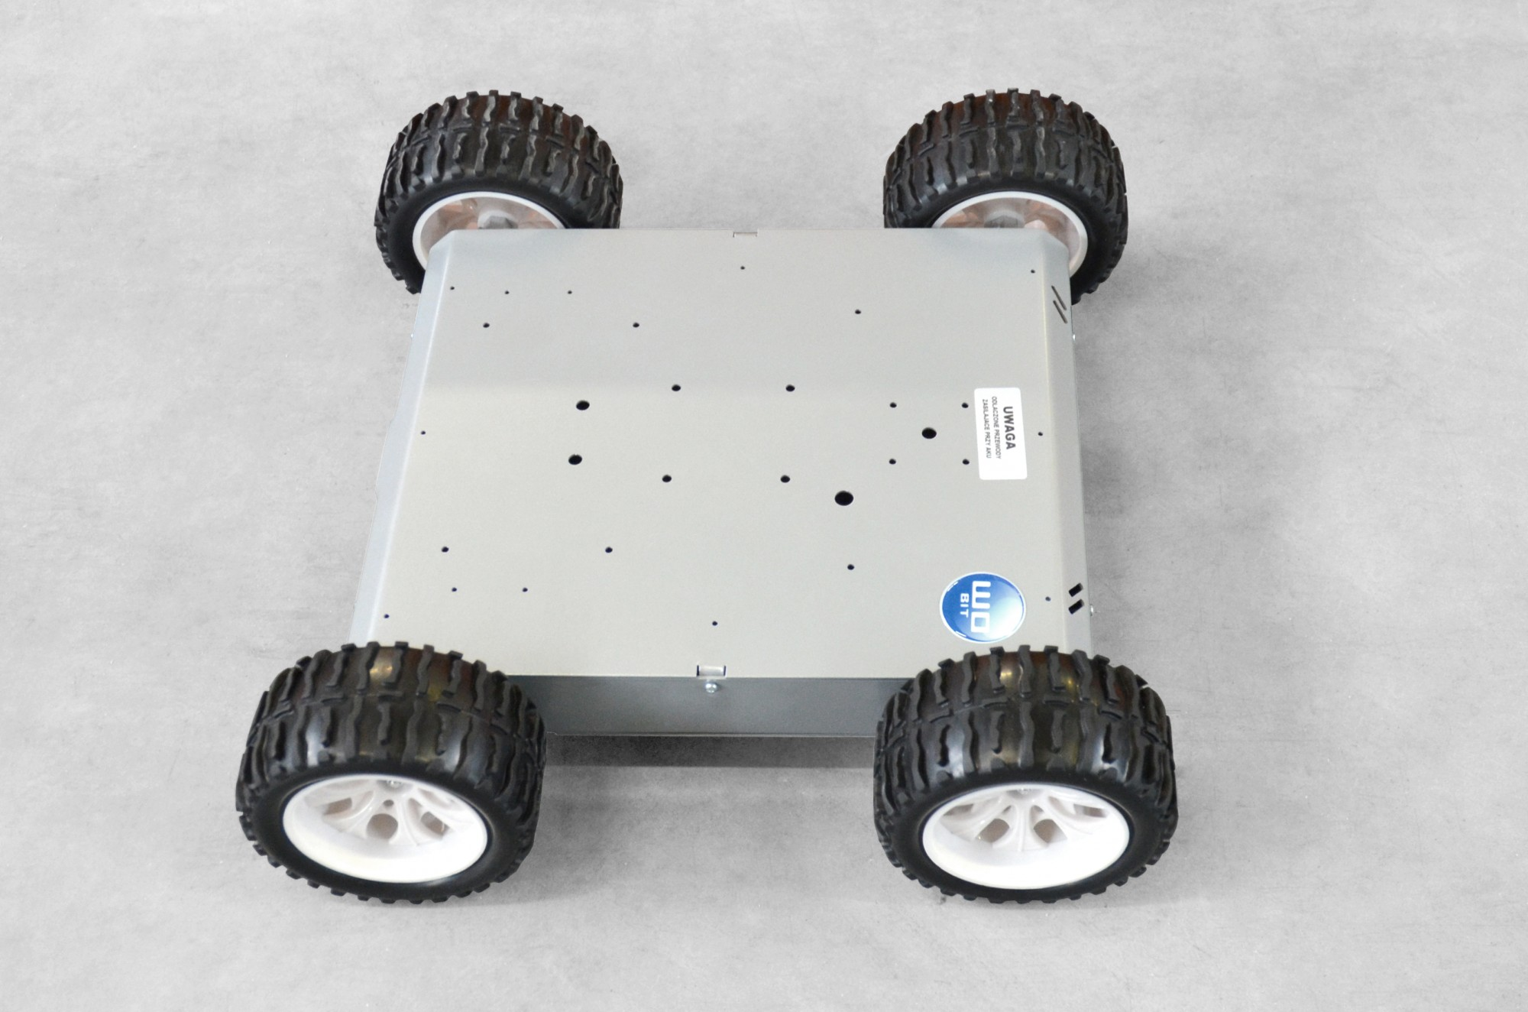
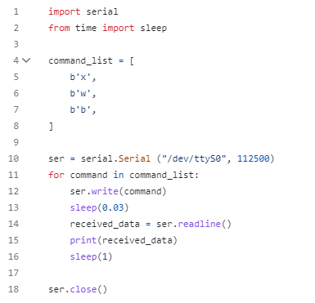
We can control platform movements through UART communication with platform controller ATmega128. In addition to this, we can show to control platform with python script. We managed to connect camera and platform to one raspberry Pi make video stream from camera and remotely (through wifi drive it in campus)

Slide 6
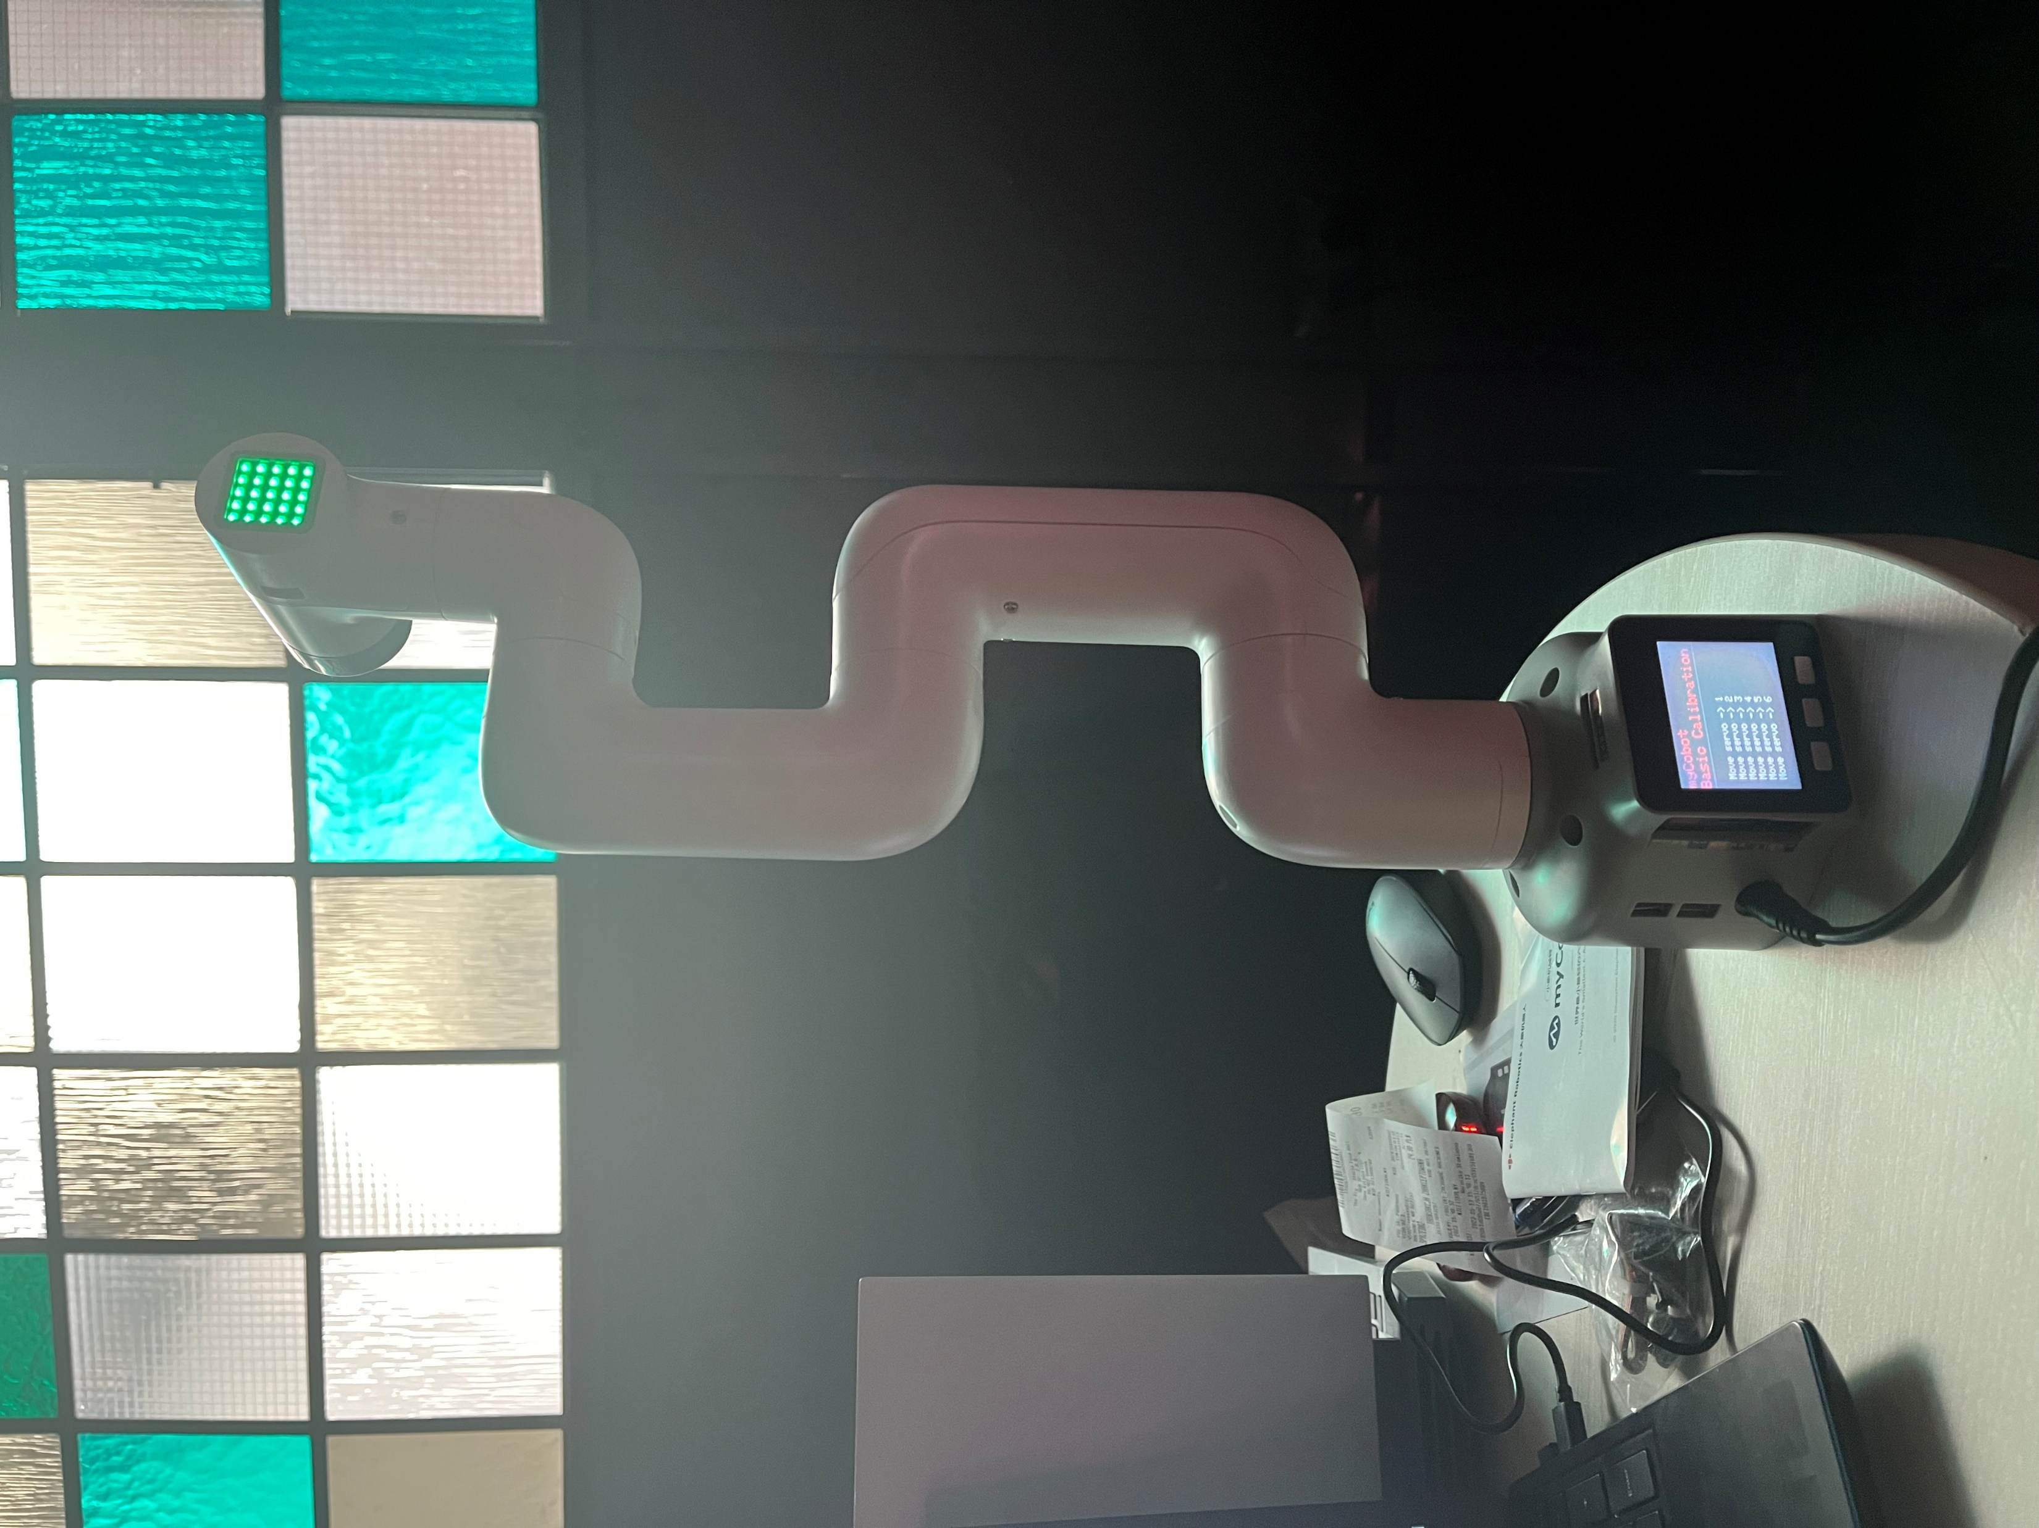
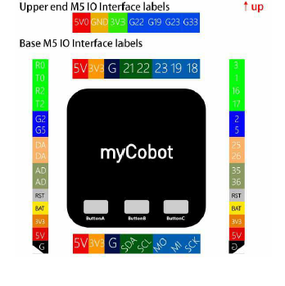
ABOUT THE ROBOTIC ARM
myCobot 280 for M5 stack - myCobot is the smallest and lightest six-axis collaborative robot, jointly produced byElephant Robotics and M5Stack. It is more than a productivity tool full of imaginations, can carry on the secondary development according to the demands of users to achieve personalized customization.

Slide 7
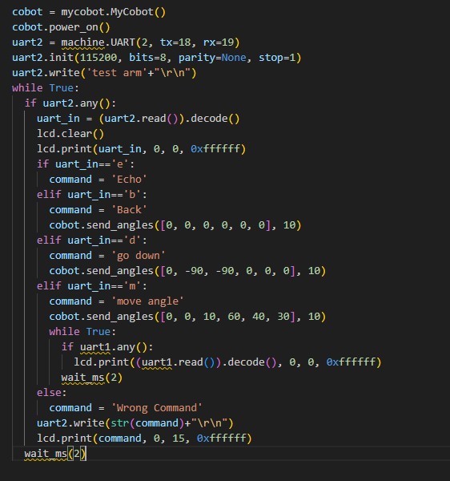
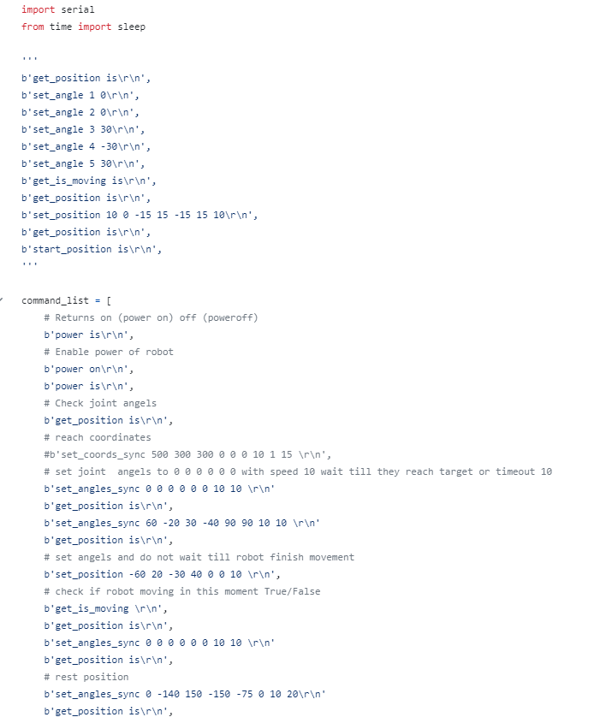
We overcame difficulties with robotic arm and now we can program it in micropython using m5stack burner and online IDE. Here we are some codes ;
We can change the angels and we can test it.

Slide 8
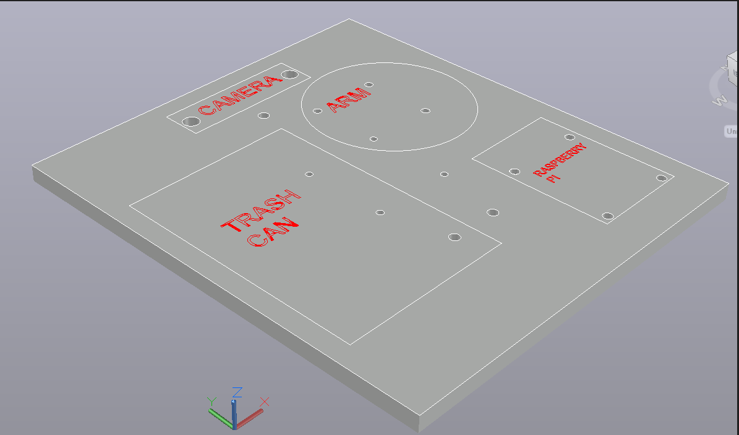
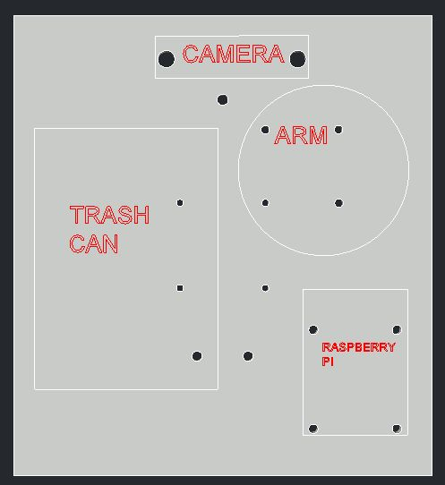
CAD MODEL
We are trying to make CAD model of mount of all parts on top of the platform. In this 3D cad model, our main goal is create a space between components and platform. We choose the position of the components and make connection between platform and this 3D model. We use autocad to create this model.

Slide 9
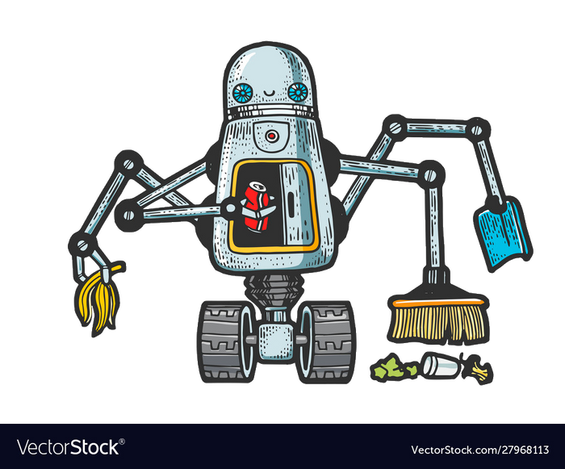



GARBAGE ROBOT TEAM
Yolo
Object Detection

Slide 10
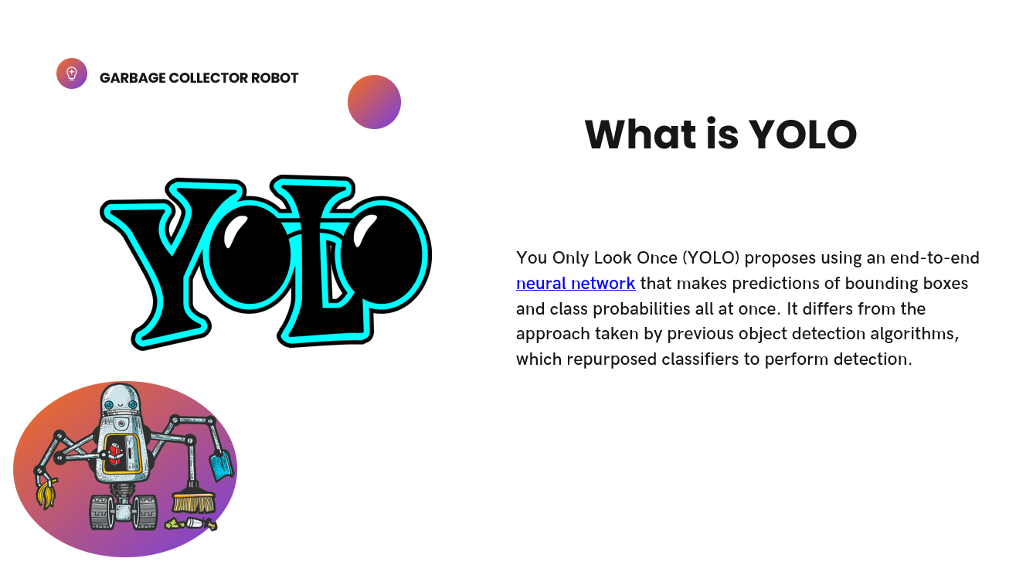

Slide 11
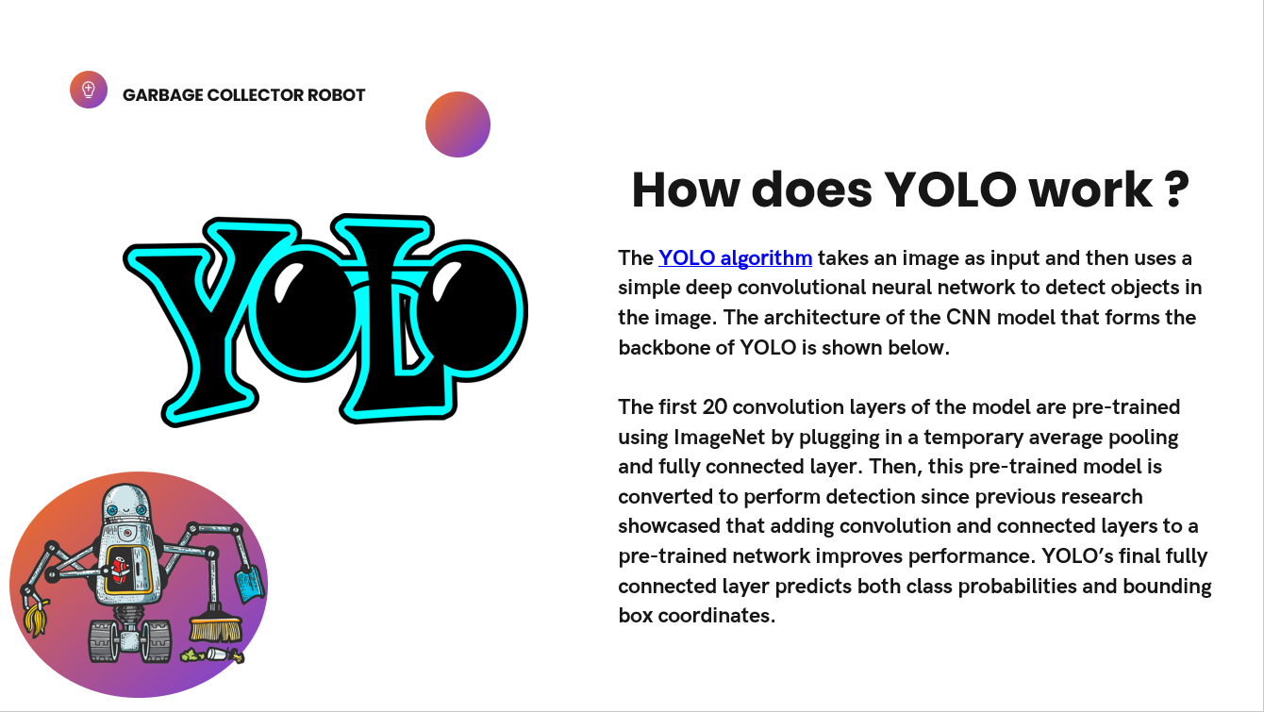

Slide 12
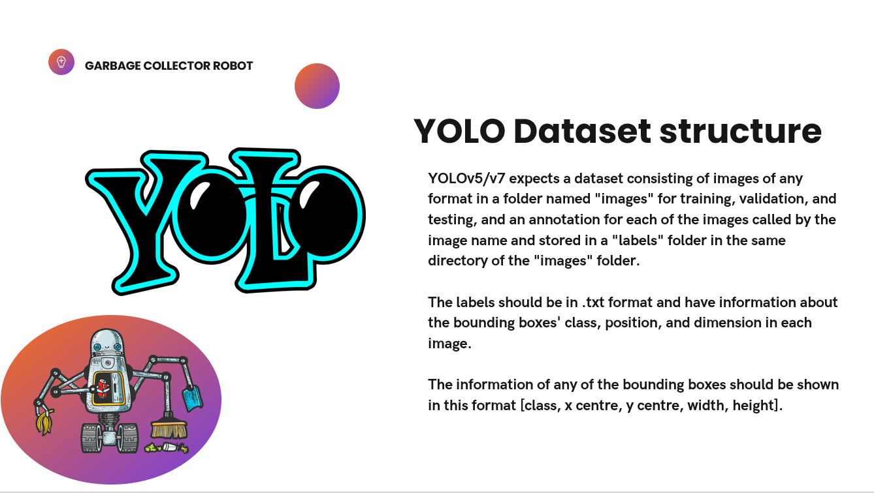

Slide 13
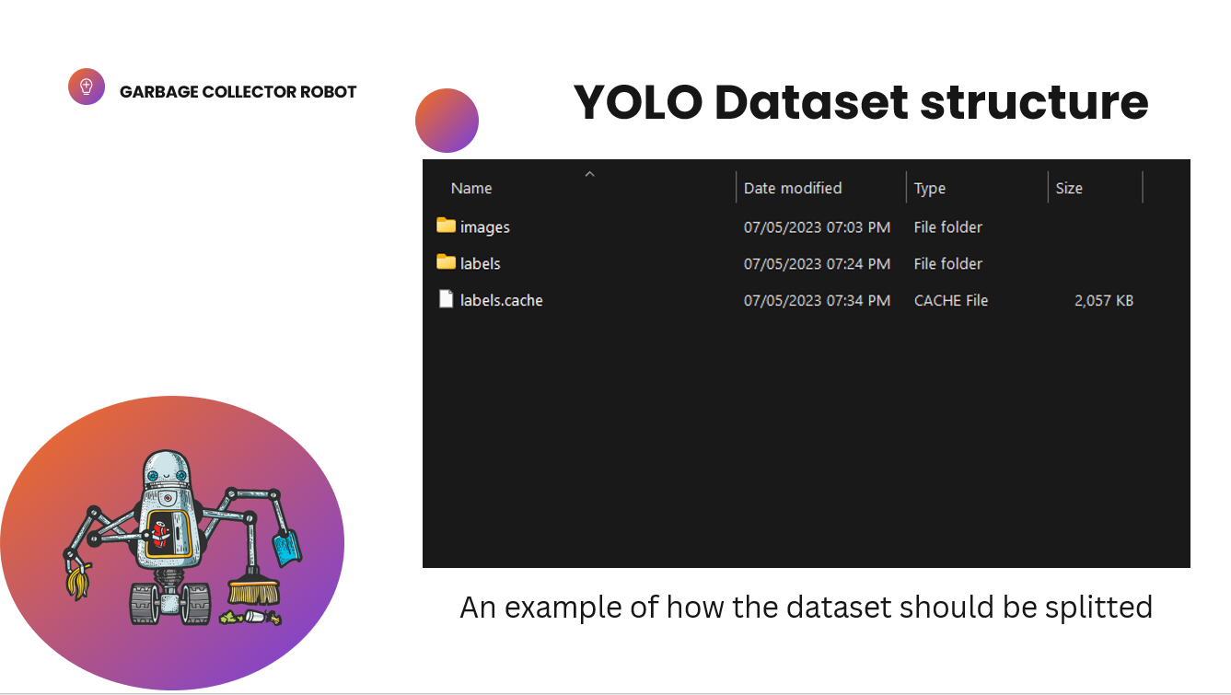

Slide 14
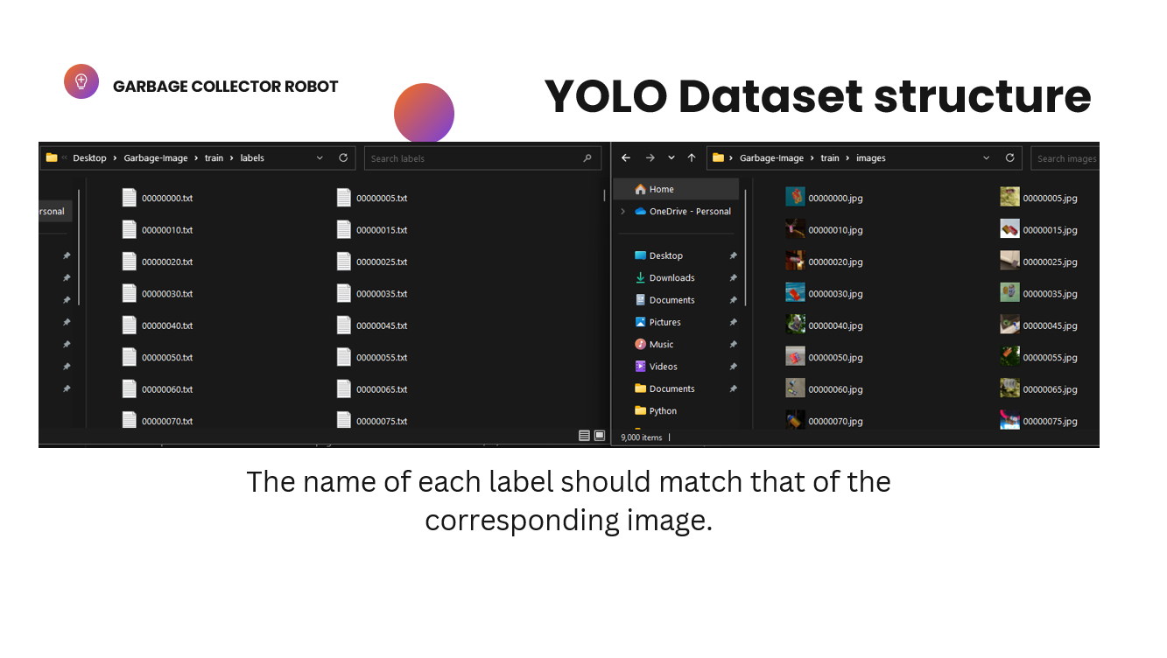

Slide 15
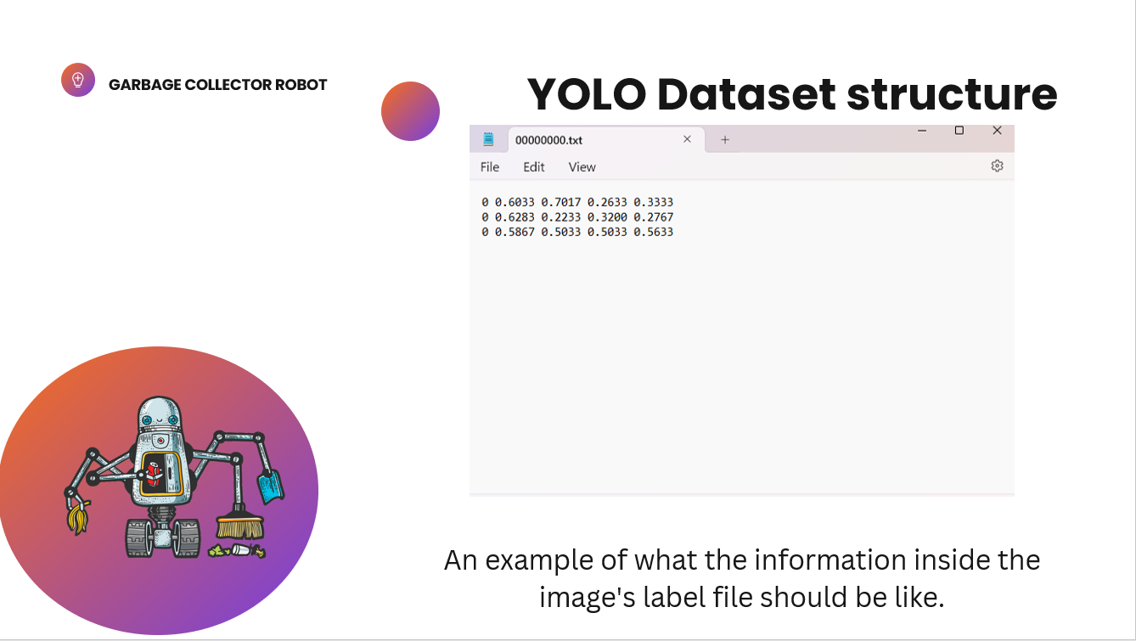

Slide 16
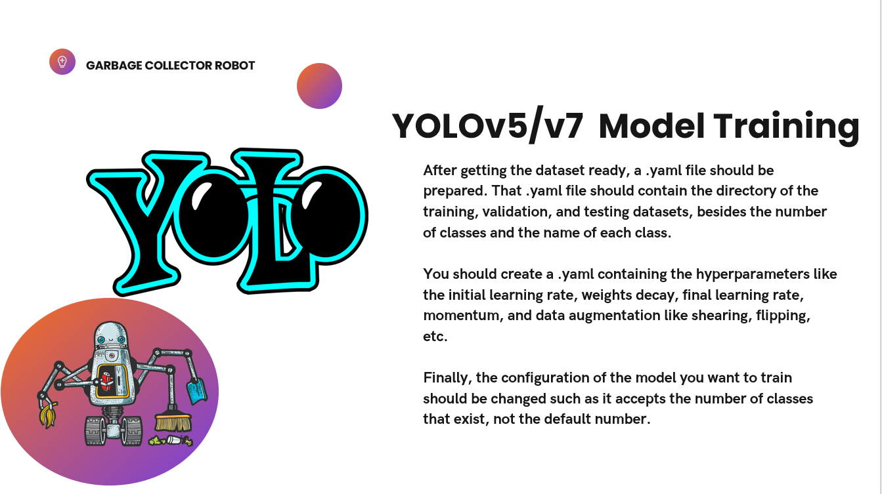

Slide 17
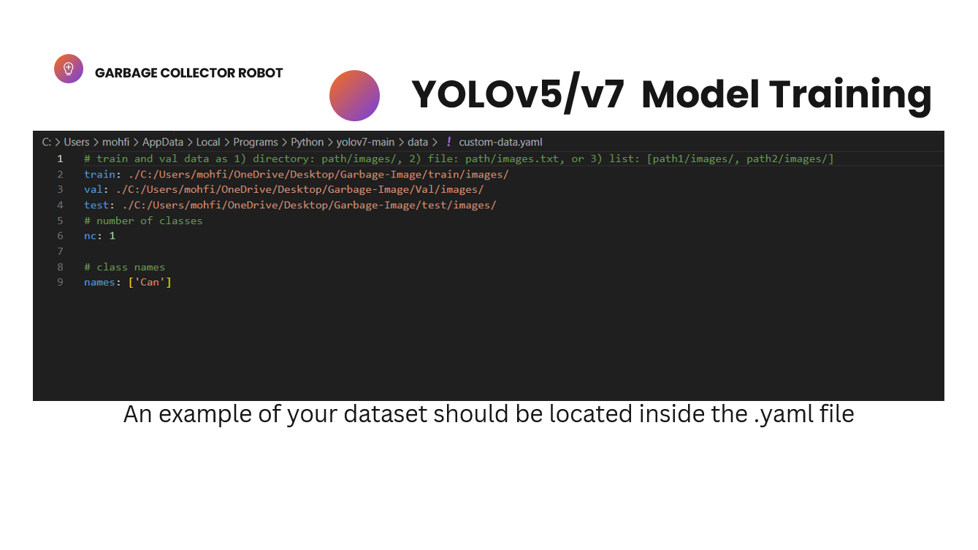

Slide 18
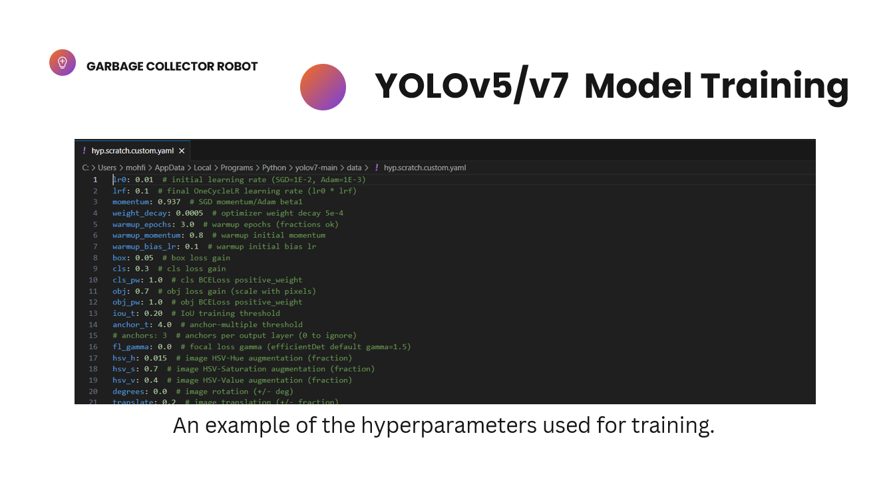

Slide 19
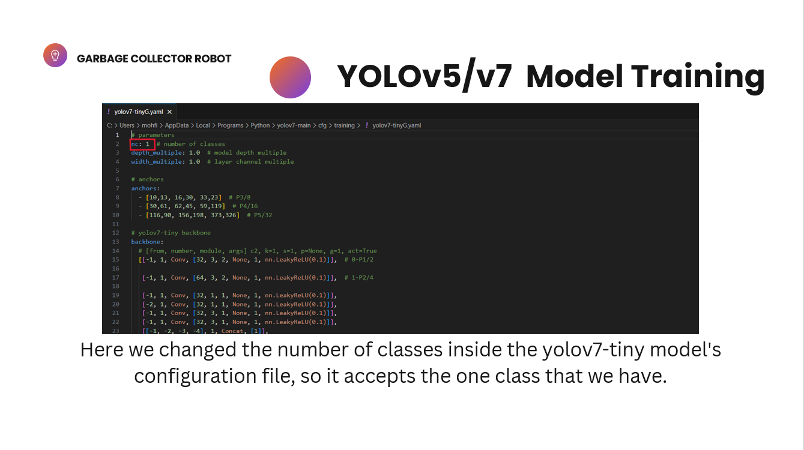

Slide 20
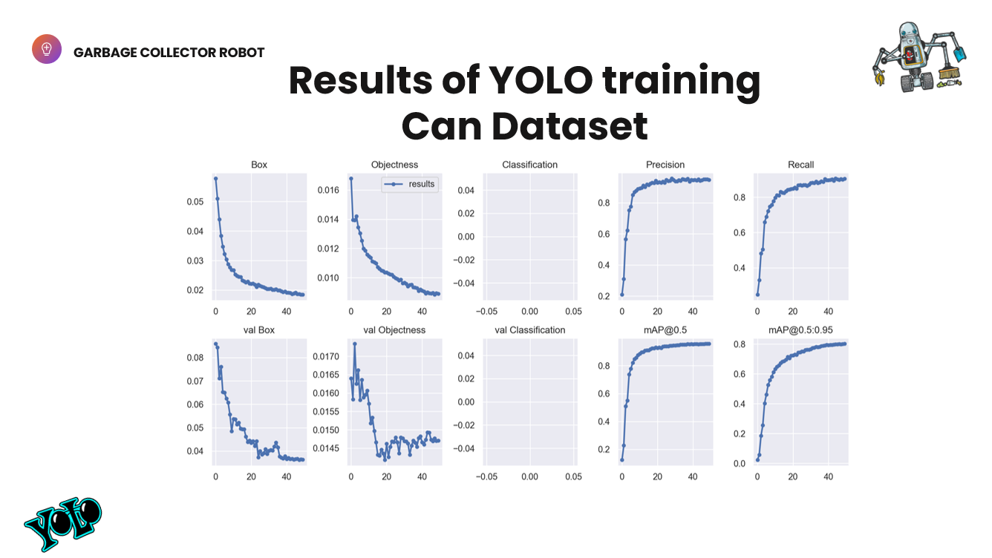

Slide 21
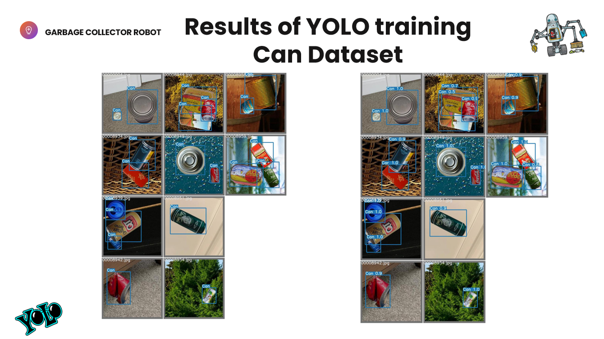

Slide 22
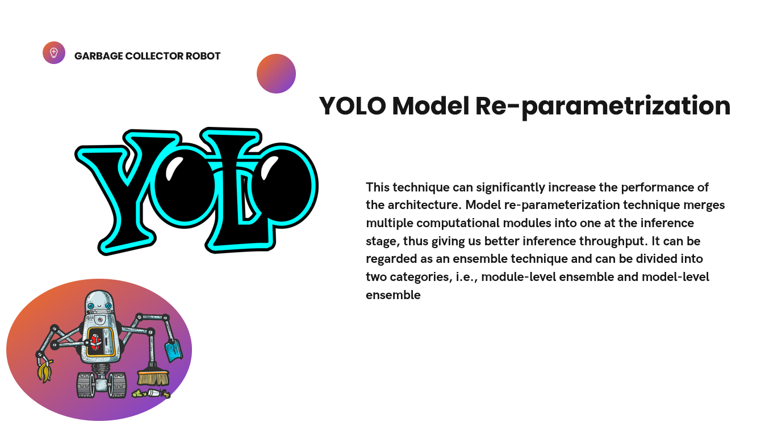

Slide 23
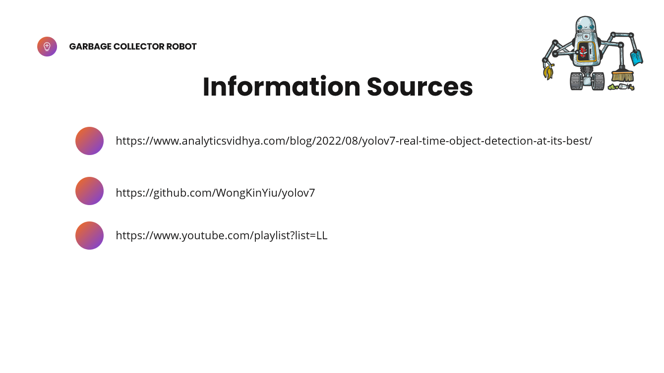

Slide 24
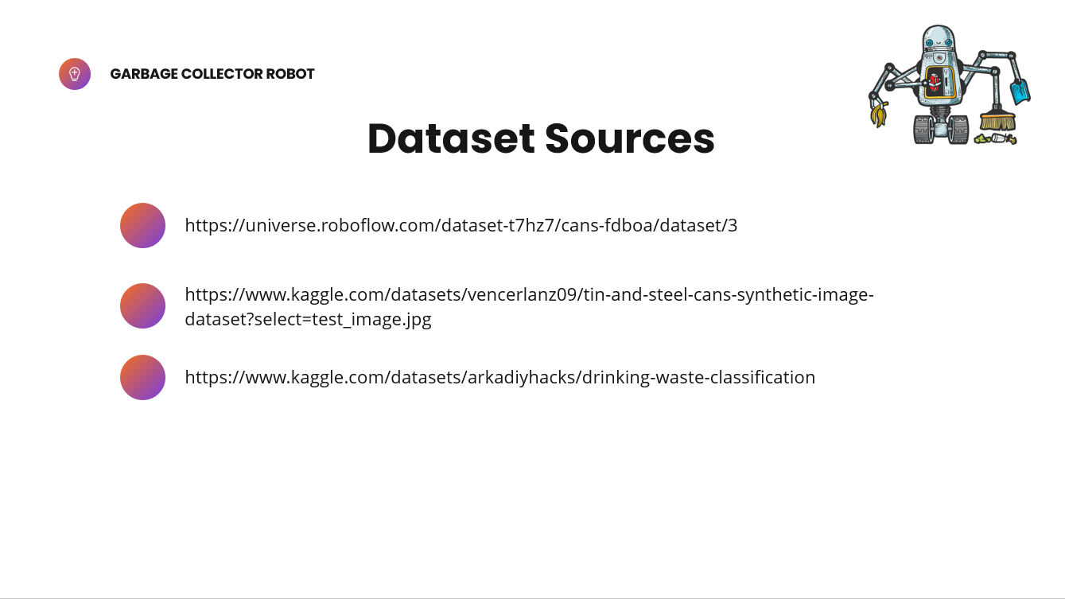

Slide 25


